Slide 4
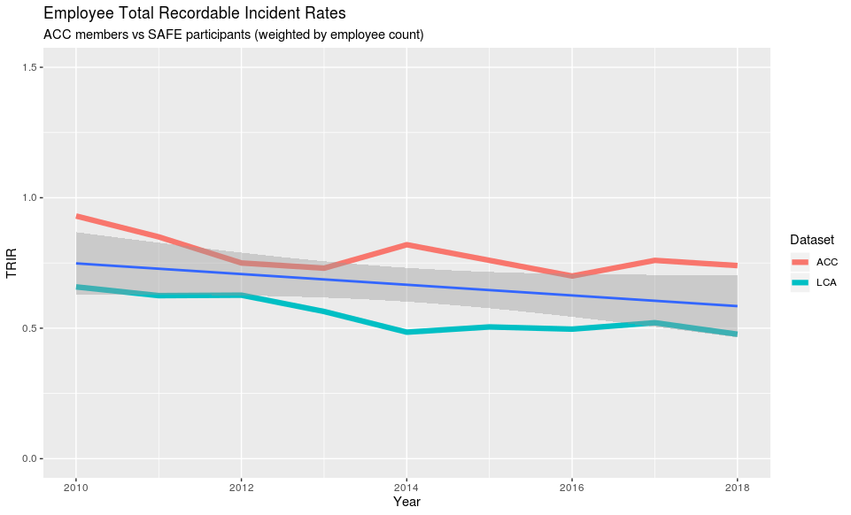

Slide 5
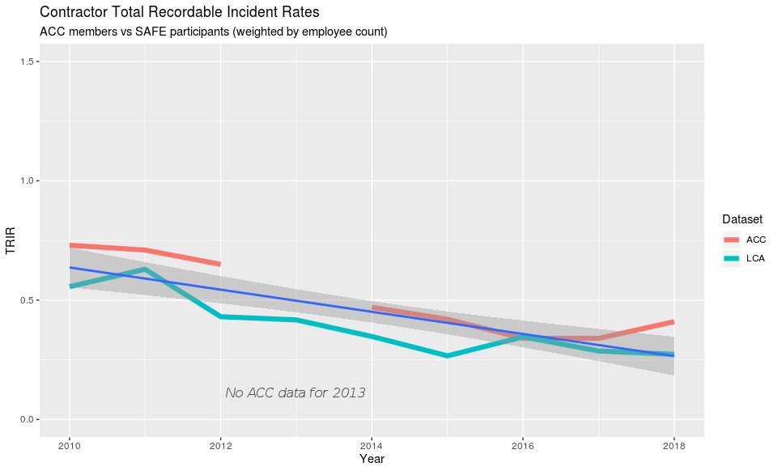

Slide 6
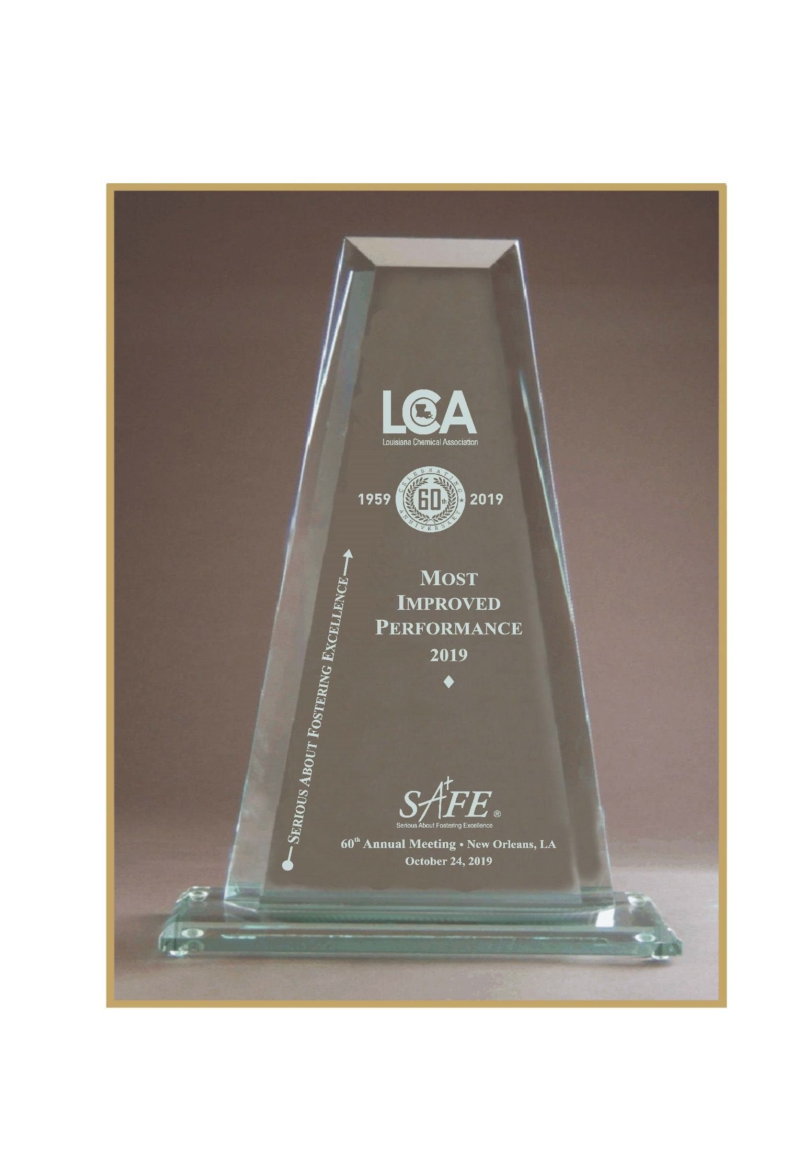

Slide 7
Class Four (16 sites)
BASF Corporation – Geismar
Bayer – Luling Plant
CF Industries
Citgo Petroleum Corporation – Lake Charles Refinery;
Chevron Oronite Company – Oak Point;
Cornerstone Chemical Company
The Dow Chemical Company – Louisiana Operations;
ExxonMobil – Baton Rouge Chemical Plant;
Noranda Alumina, Gramercy
Rubicon – Geismar
Sasol North America – Lake Charles Chemical Complex;
Shell Chemical – Geismar
Union Carbide Corporation, Wholly Owned Subsidiary of Dow Chemical Co., – St. Charles Operations;
Westlake – Lake Charles South
Westlake - Plaquemine
Westlake – Sulphur, LA

Slide 9
2019 Winner
Most Improved Performance
Noranda Alumina, Gramercy
John Habisreitinger, Executive Vice President
Joe Pampinto, Site Vice President
Carolyn Ryans, Safety Manager
Notes:
MOST improved Performance
Class 1 Chemtrade Refinery Services
Class 2 Carbo Ceramics Inc.
Class 3 UOP, Shreveport
Class 4 Westlake Chemical Corporation

Slide 10
Class Three (12 sites)
ExxonMobil – Baton Rouge Plastics Plant
ExxonMobil – Baton Rouge Polyolefins
Formosa Plastics Corp.
GRACE
Honeywell International – Geismar
Louisiana Pigment
Occidental Chemical Corp., - Geismar
Occidental Chemical Corp., - Taft
Shintech Louisiana
SNF Flopam – Plaquemine
Syngenta Crop Protection
Total Petrochemicals and Refining USA Inc. – Styrenics Complex;

Slide 12
2019 Winner
Most Improved Performance
Formosa Plastics & Chemicals, Baton Rouge
Paul Heurtevant, Plant Manager
Rusty Daigle, Mgr. Safety & Health
Notes:
MOST improved Performance
Class 1 Chemtrade Refinery Services
Class 2 Carbo Ceramics Inc.
Class 3 UOP, Shreveport
Class 4 Westlake Chemical Corporation

Slide 13
Class Two (15 sites)
Air Products & Chemicals – HyCo
Americas Styrenics Chemical Co LLC – St. James Plant;
Biolab Inc.
DuPont – Pontchartrain
Eastman Chemical Company – St. Gabriel;
Ingevity South Carolina LLC – DeRidder;
Lyondellbasell Industries – Calcasieu;
Methanex Services, LLC - Geismar
Nalco Champion, Ecolab Company
NOVA Chemicals Olefins LLC – Geismar;
Nutrien
Occidental Chemical Corp. – Convent;
Olin Chlor Alkali Products – Plaquemine;
Olin Chlor Alkali Products - St. Gabriel;
Westlake Vinyls Co LP - Geismar

Slide 15
2019 Winner
Most Improved Performance
Americas Styrenics LLC, St. James
Jacob LaSavia, Plant Manager
Guy Ward, EHS&S Manager
Notes:
MOST improved Performance
Class 1 Chemtrade Refinery Services
Class 2 Carbo Ceramics Inc.
Class 3 UOP, Shreveport
Class 4 Westlake Chemical Corporation

Slide 16
Class One (23 sites)
Air Liquide – Addis
Air Liquide - Geismar ALGUS
Air Liquide – Geismar ASU
Air Liquide – Norco
Air Liquide – Plaquemine
Air Liquide – Taft
BASF Corporation – North Geismar;
BASF Corp., Vidalia
BASF Corp., Zachary
Cabot Corporation – Ville Platte
Dexco Polymers LP – Plaquemine
Honeywell International – Baton Rouge;
Lonza, Lake Charles
Mexichem Fluor Inc. - Iberville
Praxair Inc., Member of Linde Group – Geismar;
Praxair Inc., Member of Linde Group - St. Charles;
Praxair Inc., Member of Linde Group – Sulphur;
Rain CII Carbon LLC – Chalmette
Rain CII Carbon LLC - Gramercy Calcining Plant;
Rain CII Carbon LLC - Lake Charles Calcining Plant;
Rain CII Carbon LLC – Norco
UOP, Honeywell Company – Baton Rouge;
Westlake – Lake Charles North

Slide 18
2019 Winner
Most Improved Performance
Rain CII Carbon LLC, Lake Charles
Ross Gares, Plant Manager (2016-2019)
Marvin Lubin, Plant Manager (2019-present)
Notes:
MOST improved Performance
Class 1 Chemtrade Refinery Services
Class 2 Carbo Ceramics Inc.
Class 3 UOP, Shreveport
Class 4 Westlake Chemical Corporation

Slide 21
2019 Winner
BEST IN LOUISIANA
Lonza, Lake Charles
Mark Kern, Plant Manager
Notes:
MOST improved Performance
Class 1 Chemtrade Refinery Services
Class 2 Carbo Ceramics Inc.
Class 3 UOP, Shreveport
Class 4 Westlake Chemical Corporation

Slide 23
2019 Winner
BEST IN LOUISIANA
Lyondellbasell, Lake Charles Polymers
Greg Gray, Site Manager
Gregory Satterfield, Sr. Safety Engineer
Notes:
MOST improved Performance
Class 1 Chemtrade Refinery Services
Class 2 Carbo Ceramics Inc.
Class 3 UOP, Shreveport
Class 4 Westlake Chemical Corporation

Slide 25
2019 Winner
BEST IN LOUISIANA
Shintech Louisiana
Danny Cedotal, VP of Manufacturing
Joel Prejean, Site Services Manager
Tim Bergeron, Environmental Manager
Chris Boggs, Safety Superintendent
Notes:
MOST improved Performance
Class 1 Chemtrade Refinery Services
Class 2 Carbo Ceramics Inc.
Class 3 UOP, Shreveport
Class 4 Westlake Chemical Corporation

Slide 27
2019 Winner
BEST IN LOUISIANA
ExxonMobil
Baton Rouge Chemical Plant
Dave Leucke, Plant Manager
Brad Allen, SSHE Manager
Notes:
MOST improved Performance
Class 1 Chemtrade Refinery Services
Class 2 Carbo Ceramics Inc.
Class 3 UOP, Shreveport
Class 4 Westlake Chemical Corporation

